Slide 1
Employee Data Analysis using Excel
STUDENT NAME: R.SANDHIYA
REGISTER NO: 312216517 autunm1647cb1221647006
DEPARTMENT: BBM
COLLEGE:R.B.GOTHI JAIN COLLEGE FOR WOMEN

Slide 2
PROJECT TITLE
Employee Performance Analysis using Excel

Slide 3


AGENDA
Problem Statement
Project Overview
End Users
Our Solution and Proposition
Dataset Description
Modelling Approach
Results and Discussion
Conclusion
3/21/2024 Annual Review

Slide 4


PROBLEM STATEMENT

Slide 5
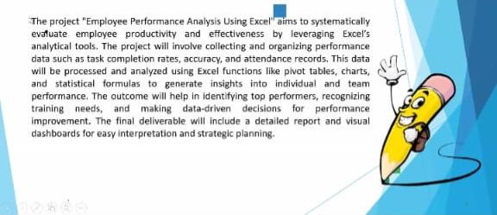

PROJECT OVERVIEW
.

Slide 6

WHO ARE THE END USERS?
Organization
Students
company

Slide 7

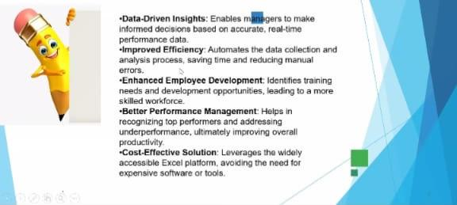
OUR SOLUTION AND ITS VALUE PROPOSITION

Slide 8
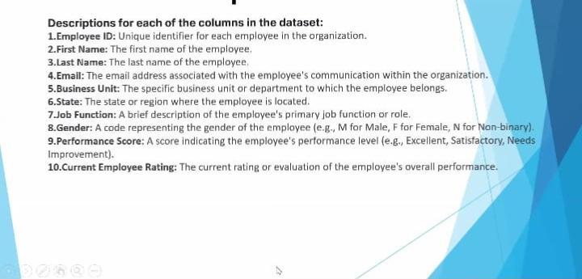
Dataset Description

Slide 9
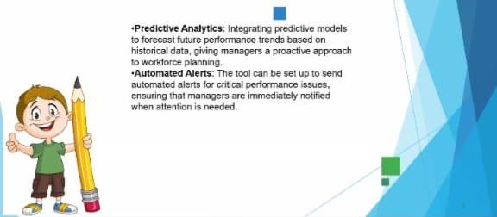

THE "WOW" IN OUR SOLUTION
3/21/2024 Annual Review
9

Slide 10
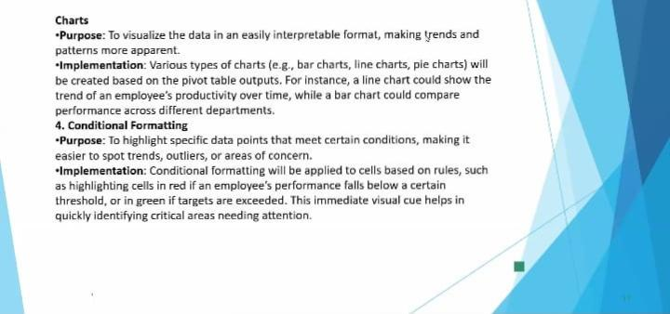
MODELLING
10

Slide 11

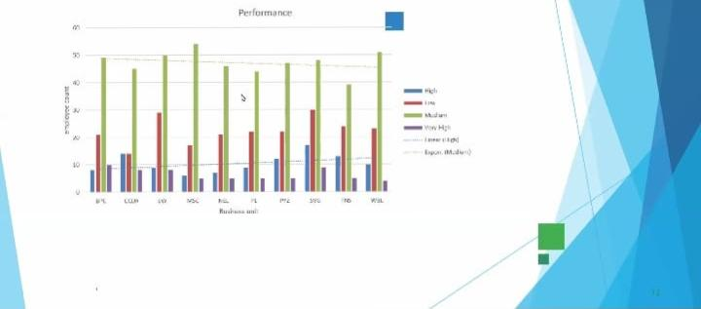
RESULTS
11

Slide 12
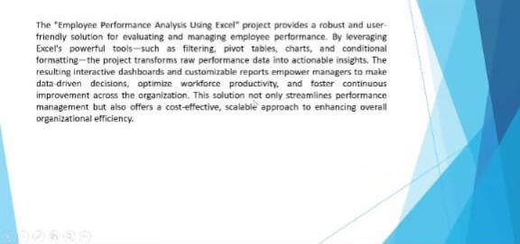
conclusion

